Slide 1
DEVELOPMENT OF INTERATRIAL AND INTERVENTRICULAR SEPTUM
RANJITH
SENIOR RESIDENT
DEPT. CARDIOLOGY
CALICUT MEDICAL COLLEGE

Slide 2
Heart embryology
Right and left Endocardial heart tubes
Both fuse together
The single tube- series of dilatations
Bulbus cordis
Primitive Ventricle
Primitive atrium
Sinus venosus

Slide 3
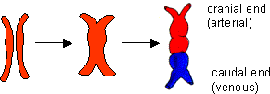

Slide 4
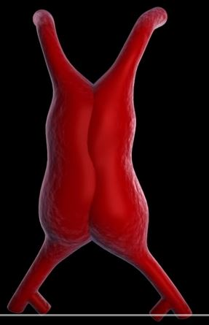

Slide 5
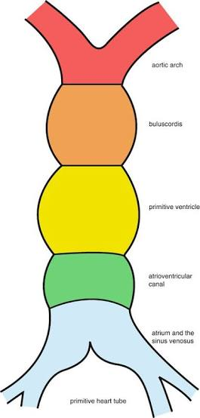

Slide 6
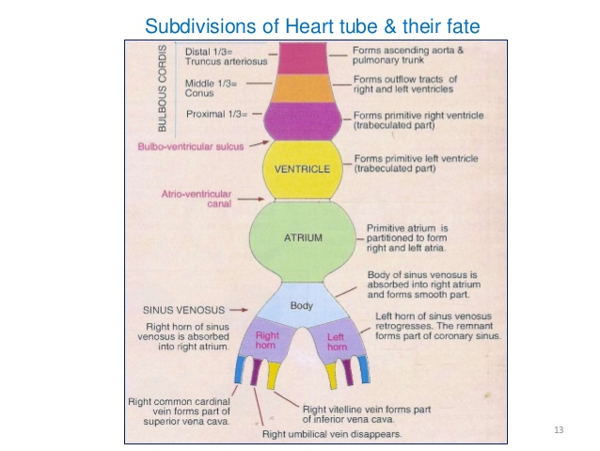

Slide 7
Sinus venosus and its absorption into the right ventricle
This is the caudal most part of the primitive heart tube.
It represents a body with two prolongations that are referred to as its right and left horns
Vitelline vein
Umbilical vein
Common cardinal vein / duct of cuvier
Initially both horns are of equal size

Slide 8
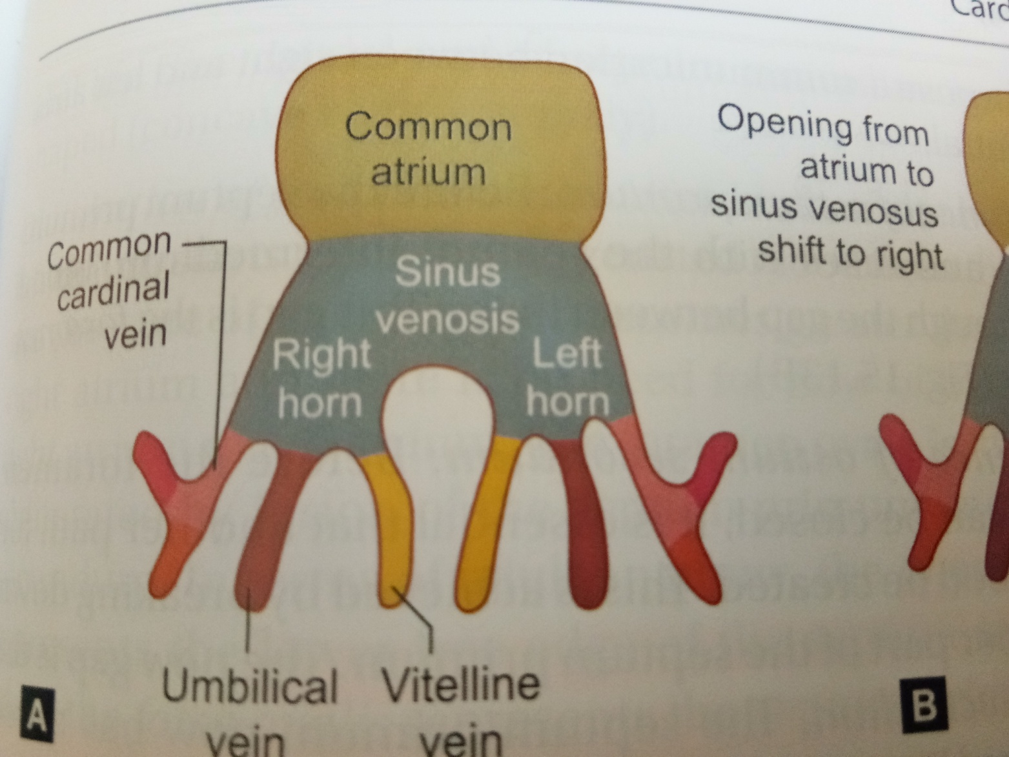

Slide 9
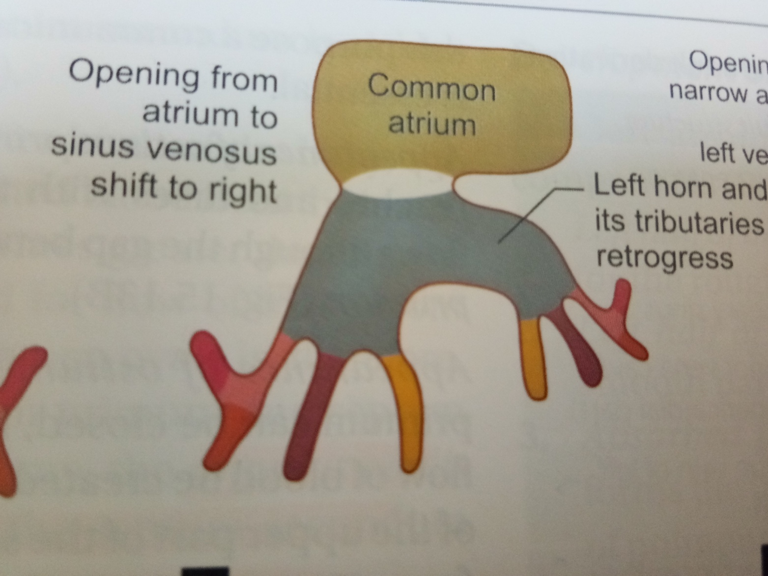

Slide 10
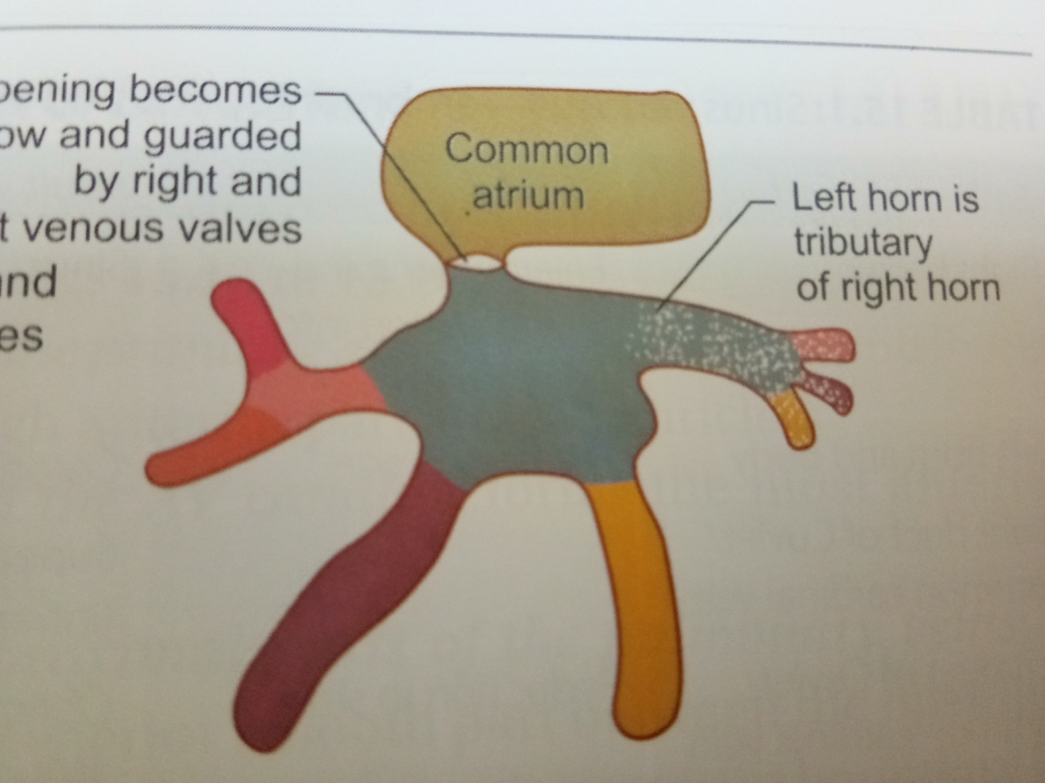

Slide 11
Regression of left horn and its tributaries-
The right groove remains shallow but the left one becomes very deep
It results in that left part becomes completely separated from the atrial chamber.
The left horn becomes reduced in size and appears like a tributary of the right horn of sinus venosus.
The left horn becomes part of coronary sinus

Slide 12
Sinoatrial orifice
Initially sinoatrial orifice- transverse, larger and median in position
Later the opening becomes narrow and shifts to the right and onto the dorsal aspect of the atrium
It changes its orientation from transverse to oval and finally to vertical with a narrow slit

Slide 13
Fate of tributaries of sinus venosus
Embryonic part | Adult part
Left horn and body | Coronary sinus
Right common cardinal vein | SVC
Right vitelline vein | IVC

Slide 14
Atrial septation
The primary atrial septum (septum primum) forms by active growth of a myocardial septum
Initially the primordium of this septum can be seen as a ridge in the medial roof of the common atrium.
The leading edge of the ridge is covered with a mesenchymal cap termed the spina vestibuli, which is contiguous superiorly with the superior AV cushion and inferiorly with the inferior AV cushion

Slide 15
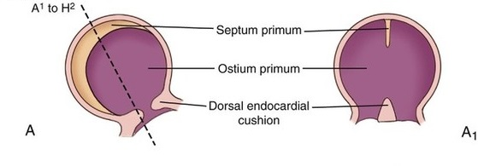

Slide 16
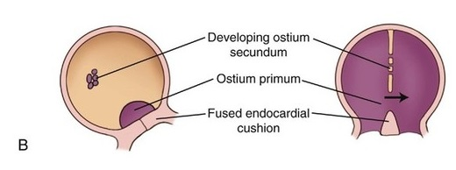

Slide 17
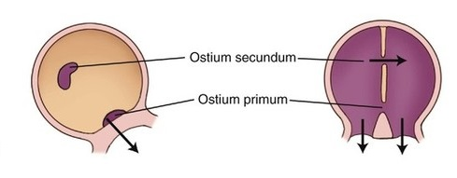

Slide 18
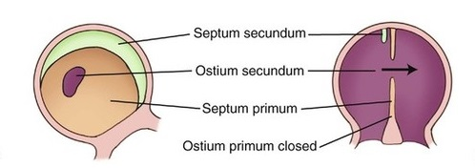

Slide 19
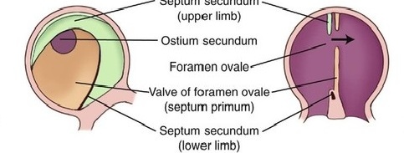

Slide 20
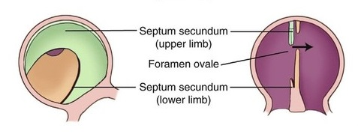

Slide 21
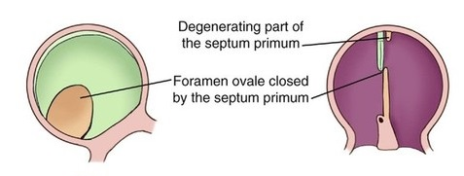

Slide 22
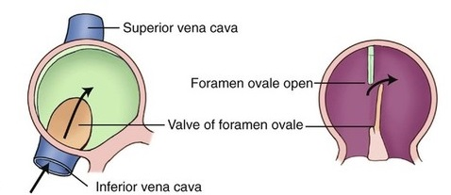

Slide 23
As the primary septum descends from the roof of the atrium toward the AV canal, thereby decreasing the size of the primary interatrial foramen (ostium primum), the mesenchymal leading edge continues to fuse with the AV cushions, which themselves are also in the process of fusing.
These events result in closure of the primary interatrial formanen (ostium primum) and the formation of the central fibrous body

Slide 24
Concomitantly, perforations appear in the superior aspect of the primary atrial septum.
These perforations coalesce, resulting in the secondary atrial foramen (or ostium secondum).
Next the secondary atrial septum develops as an infolding of the atrial roof located between the primary septum and the left venous valve.
The foramen ovale is the opening bordered by the free edge of the septum secondum
After fusion of the septum primum with the septum secondum, the foramen ovale becomes the fossa ovalis.

Slide 25
Once the two septa overlap blood has to flow through the interval between the septa. This gap is the foramen ovale
It is an oblique valvular passage that allows blood to flow from right to left but not left to right.
This is patent throughout fetal life

Slide 26
Obliteration of the foramen ovale
After birth of the baby, the left atrium starts receiving oxygenated blood from the lungs, the pressure of this chamber becomes greater than that of right atrium and there is no need for flow of blood from right atrium to left atrium.
The foramen ovale is, therefore, obliterated by fusion of the septum primum and septum secondum.
Annulus ovalis represents the lower free edge of the septum secondum while the fossa ovalis represents the septum primum

Slide 27
Multiple genetic factors including Tbx5, Nkx-2.5, Evc and Prk-AR1, have been identified in patients with abnormal atrial morphogenesis and septation

Slide 28
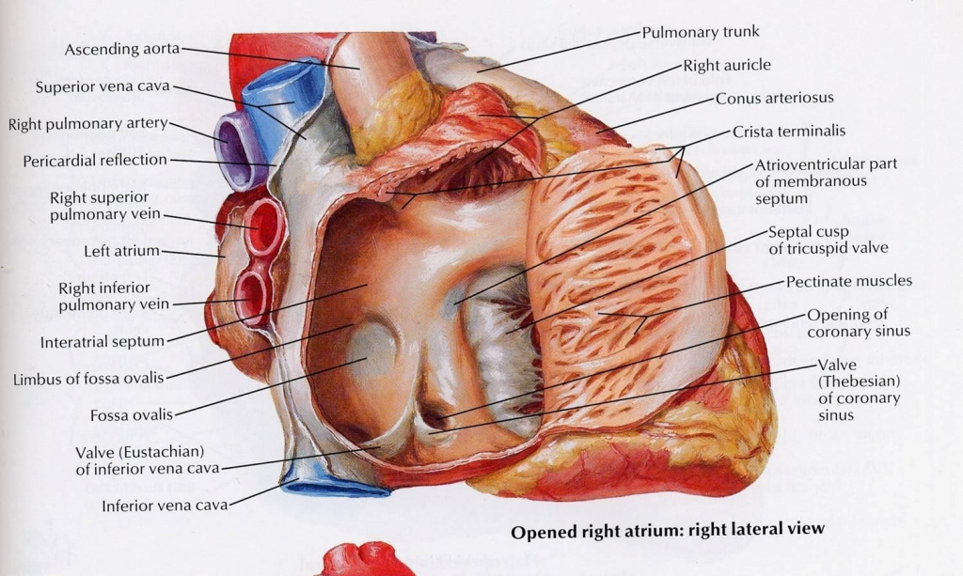

Slide 29
The fossa ovalis oocupies about 28% of the septal area, irrespective of the age, and is bordered by a limbus and guarded by a valve.
After birth the patent foramen ovale closes via fusion of its valve with the limbus of fossa ovalis as left atrial pressure exceeds right atrial pressure.
The incidence of persistent patency of foramen ovale declines from about 1/3 during the first three decades of life to about ¼ during fourth to eighth decades
Redundancy of the valve of the foramen is responsible for an atrial septal aneurysm

Slide 30
AV CANAL
Division of the AV canal into left and right sided orifices occurs as a result of fusion of the superior and inferior AV cushions.

Slide 31
Atrioventricular canal
This is the communication between common atrial chamber and ventricle.
The AV canal divides into right and left halves as follows-
The AV canal is circular in shape initially and later becomes traverse.
Two thickenings, the AV endocardial cushions appear on the dorsal and ventral walls of AV canal by proliferation of subendocardial mesenchymal cells around right and left AV canals.

Slide 32
They grow toward each other and fuse. The fused cushions form the septum intermedium.
The AV endocardial cushions take part in the formation of interatrial and interventricular septa

Slide 33
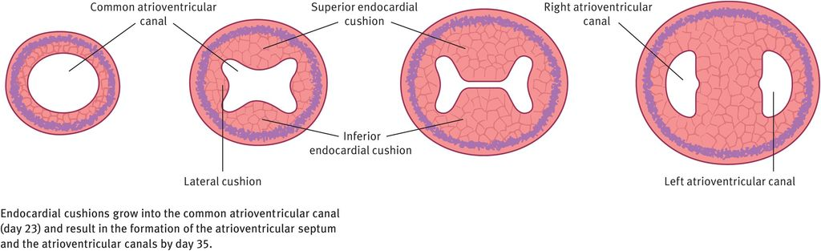

Slide 34
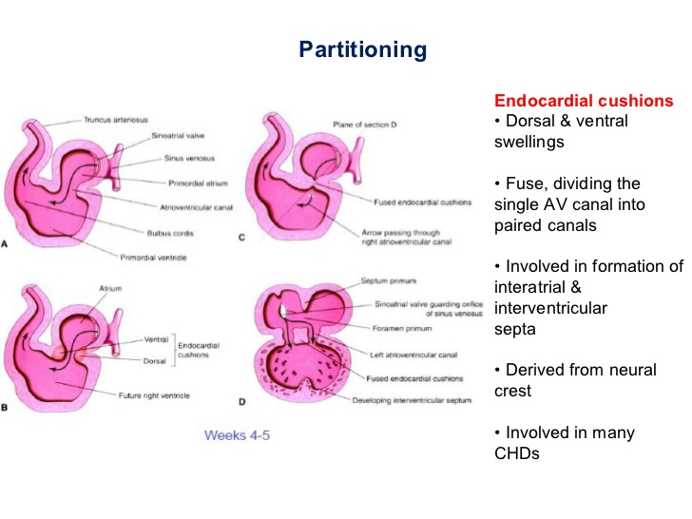

Slide 35
Interventricular septum formation
The ventricular cavity formed after the conus and the proximal one third of bulbus cordis has merged into the primitive ventricle and has to be subdivided into right and left halves in such a way that each half communicates with the corresponding atrium
The interventricular septum consists of three parts that develop from different sources.
1.muscular
2.bulbar
3.membranous

Slide 36
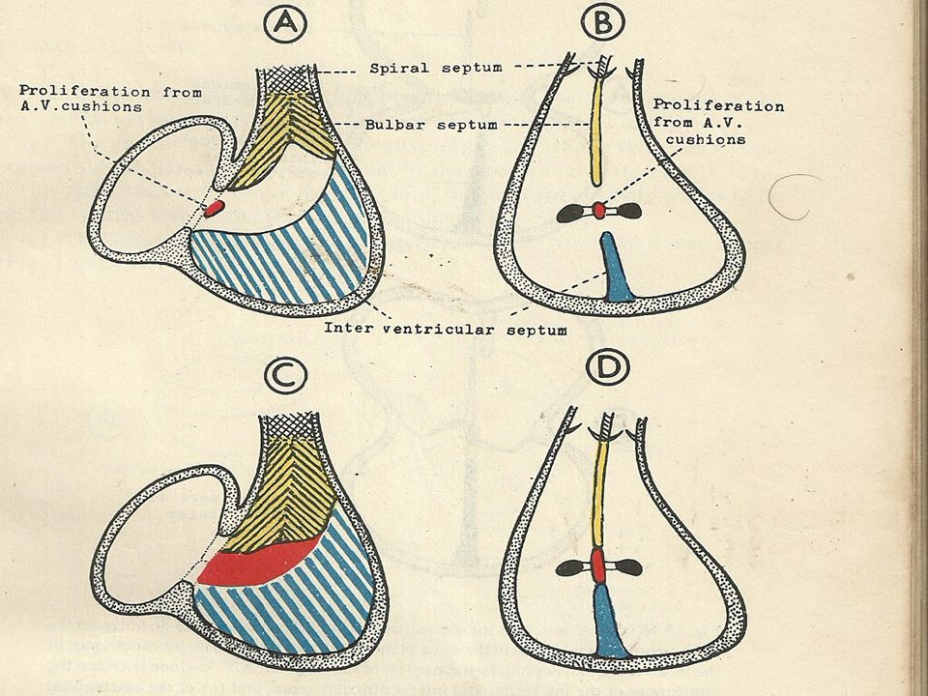

Slide 37
Muscular – a septum called interventricular septum grows upward from the floor of the bulboventricular cavity and divides the lower dilated part of this cavity into right and left halves.
Passive dilatation of bulboventricular cavities on either side of the septum and hemodynamic forces are responsible for this formation
It meets the fused AV cushions (septum intermedium) and partially fuses with them.
On external surface of the heart, the site of formation of the interventricular septum corresponds to the bulboventricular sulcus

Slide 38
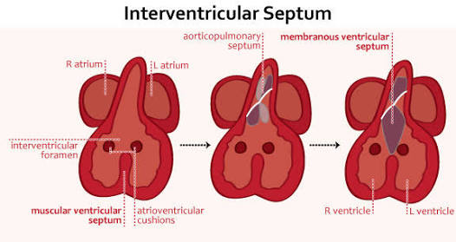

Slide 39
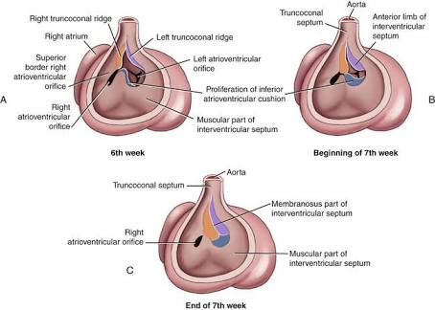

Slide 40
The cephalic margin of the septum is free, concave and twisted
It presents a dorsal and a ventral horn. The dorsal horn fuses with right edge of dorsal AV cushion and the ventral horn fuses with the left edge of ventral AV cushion.
An interventricular foramen appears between the two ventricles at the upper margin of interventricular septum.
The closure of interventricular foramen is facilitated by septum intermedium and proximal bulbar septum

Slide 41
Bulbar part
Two ridges termed the right and left bulbar ridges arise in the wall of the bulboventricular cavity (in the part derived from the conus)
The right ridge arises from the dorsal and right wall and is cephalic to right AV orifice. The left ridge arises from the ventral and left wall.
These ridges grow toward each other and fuse to form a bulbar septum.
The right ridge is in line with the dorsal horn and the left ridge with the ventral horn of muscular part of AV septum.

Slide 42
Fusion of right and left bulbar ridges forms the proximal bulbar septum. The bulbar septum grows downward toward the muscular part of interventricular septum but does not quite reach it, with the result that a gap is still left between the two.

Slide 43
Membranous part
The gap between the upper edge of interventricular septum and the lower edge of the bulbar septum is filled by proliferation of tissue from the right side of the AV cushions and the right and left bulbar ridges.
The membranous part of the interventricular septum is divisible into an anterior part which separates the right and left ventricles and a posterior part which separates the left ventricle from the right atrium ( also called AV septum).

Slide 44
The anterior part is derived from the proliferation of tissue from the endocardial cushions
The interatrial and interventricular septa do not meet the AV cushions in the same line.
As a result, a part of these cushions separates the left ventricle from the right atrium. This part of the AV cushions forms the posterior part of the membranous septum

Slide 45
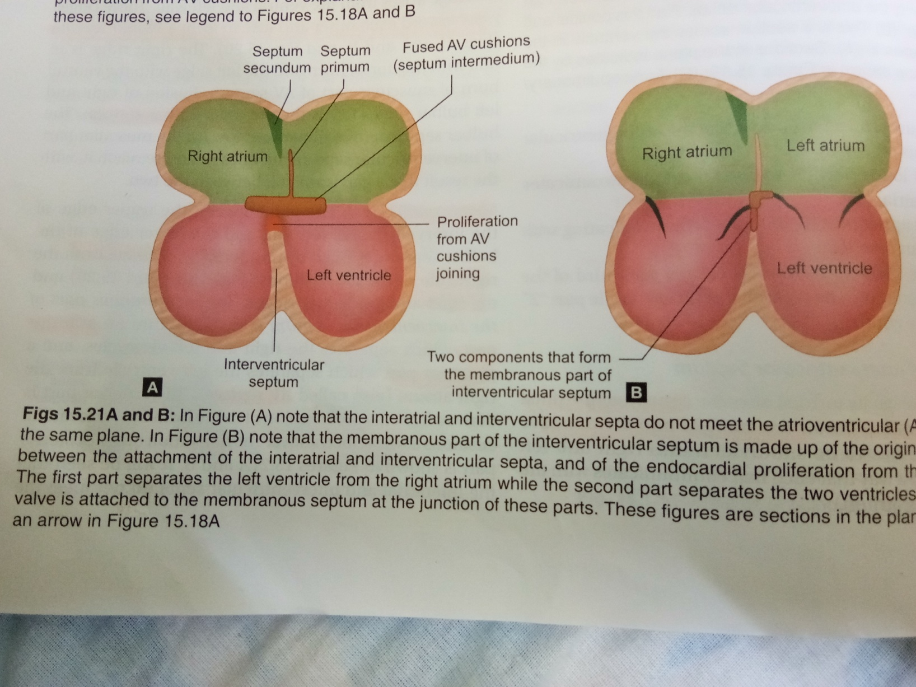

Slide 46
Developmental anomalies

Slide 47
ATRIAL SEPTAL DEFECT
The most common type of ASD is the ostium secundum or fossa ovalis location.
Ostium secundum defects result from shortening of the valve of the foramen ovale, excessive resorption of the septum primum, or deficient growth of the septum secundum.
Occasionally the atrial septal perforations resembles swiss cheese or the interatrial communication is represented by multiple openings less than 5 mm in diameter

Slide 48
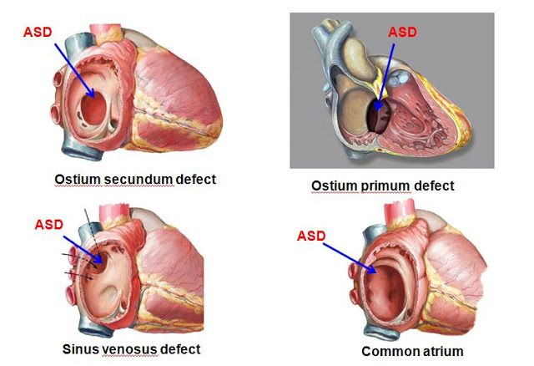

Slide 49
Ostium primum
Next in frequency are ostium primum defects also called atrioventricular septal defects because the atrioventricular septum is defective
Sinus venosus atrial septal defects are uncommon which constitute about 2-3% of interatrial communication.
During normal embryogenesis, the inferior vena cava and the right superior vena cava are incorporated into the right horn of the sinus venosus.
Faulty resorption results in a communication near the orifice of the SVC or IVC

Slide 50
Superior vena caval sinus venosus defects are located immediately below the junction of the superior vena cava and the right atrium and vary from small to nonrestrictive.
The orifice of superior vena cava may override the defect which is therefore biatrial.

Slide 51
Inferior vena caval sinus defects are located below the foramen ovale and merge with the floor of the inferior cava.
As the valve of the IVC resorbs its rudiment becomes the fetal eustachian valve that directs IVC blood across the foramen ovale
Persistence of a large eustachian valve channels IVC blood across an ostium secondum atrial septal defect or across an inferior vena caval sinus venosus defect

Slide 52
Coronary sinus atrial septal defects are uncommon but not rare
The defect is located at the site normally occupied by the right atrial ostium of the coronary sinus.
It is characterised by an opening in the wall of the distal end of the sinus or by unroofing caused by absence of the partition between the coronary sinus and left atrium.

Slide 53
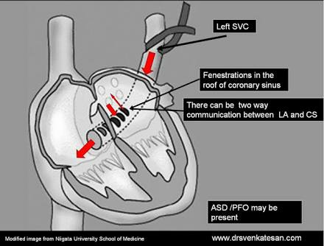

Slide 54
Common av canal defects
AV canal defects are characterised by defects in isolation or combination, including an ASD in the lowermost part of the atrial septum (ostium primum), a cleft of the mitral valve (either alone or in combination with a cleft of the tricuspid valve), or VSD.
In the most severe form (complete AV canal defect), there is a large ostium primum ASD, a large VSD in the upper muscular septum, and a common AV valve straddling the ventricular septum
The condition appears to result from incomplete growth of the AV endocardial cushions and the AV septum

Slide 55
pathology
The ostium primum type of ASD is characterised by a crescent shaped upper border with no septal tissue forming the lower border.
The lower aspect of the defect is bounded by the atrial surfaces of the AV valves and, in the complete type, in part by the upper edge of the ventricular septum. A small amount of septal tissue separates the defect from posterior atrial wall

Slide 56
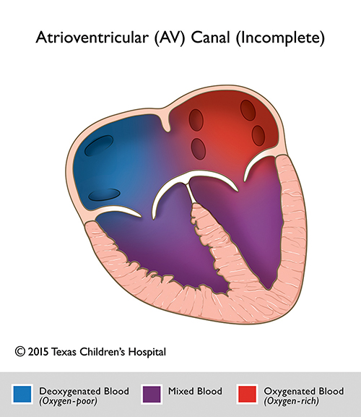

Slide 57
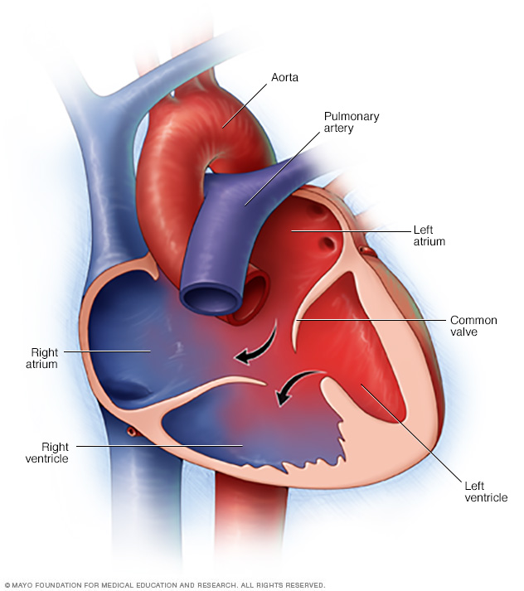

Slide 58
Anatomic types-partial
The ostium primum ASD is associated with a cleft in the anterior mitral leaflet
The tricuspid valve is not cleft or shows a minor central deficiency.
The ventricular aspects of the anterior mitral valve elements are fused to the upper edge of the deficient ventricular septum, precluding an interventricular communication
If there is no atrial septal tissue or if the atrial septum is so rudimentary that it produces a common chamber involving both atria, the term common atria or single atrium is applied

Slide 59
Complete av canal defect
The complete type of common AV canal is characterised by failure of partitioning of the primitive canal into separate AV orifices.
The orifice between the atria and the ventricles is guarded by a common valve with the anterior leaflet derived from the ventral AV endocardial cushions and represent the anterior halves of the anterior mitral and septal tricuspid leaflets.
The posterior leaflet originates from the dorsal AV endocardial cushion and represents the posterior halves of the anterior mitral and septal tricuspid leaflets

Slide 60
Usually considerable space exists between the anterior and posterior leaflets above and the ventricular septum below- thus in most cases of the complete type, there is free communication between the ventricles

Slide 61
VENTRICULAR SEPTAL DEFECT
Most common congenital malformation of the heart occurring in 50% of children with congenital heart disease
The incidence is approx 2 per 1000 live birth
Defects are classified according to their relationship to
Membranous septum
Muscular septum-
inlet
trabecular
infundibular

Slide 62
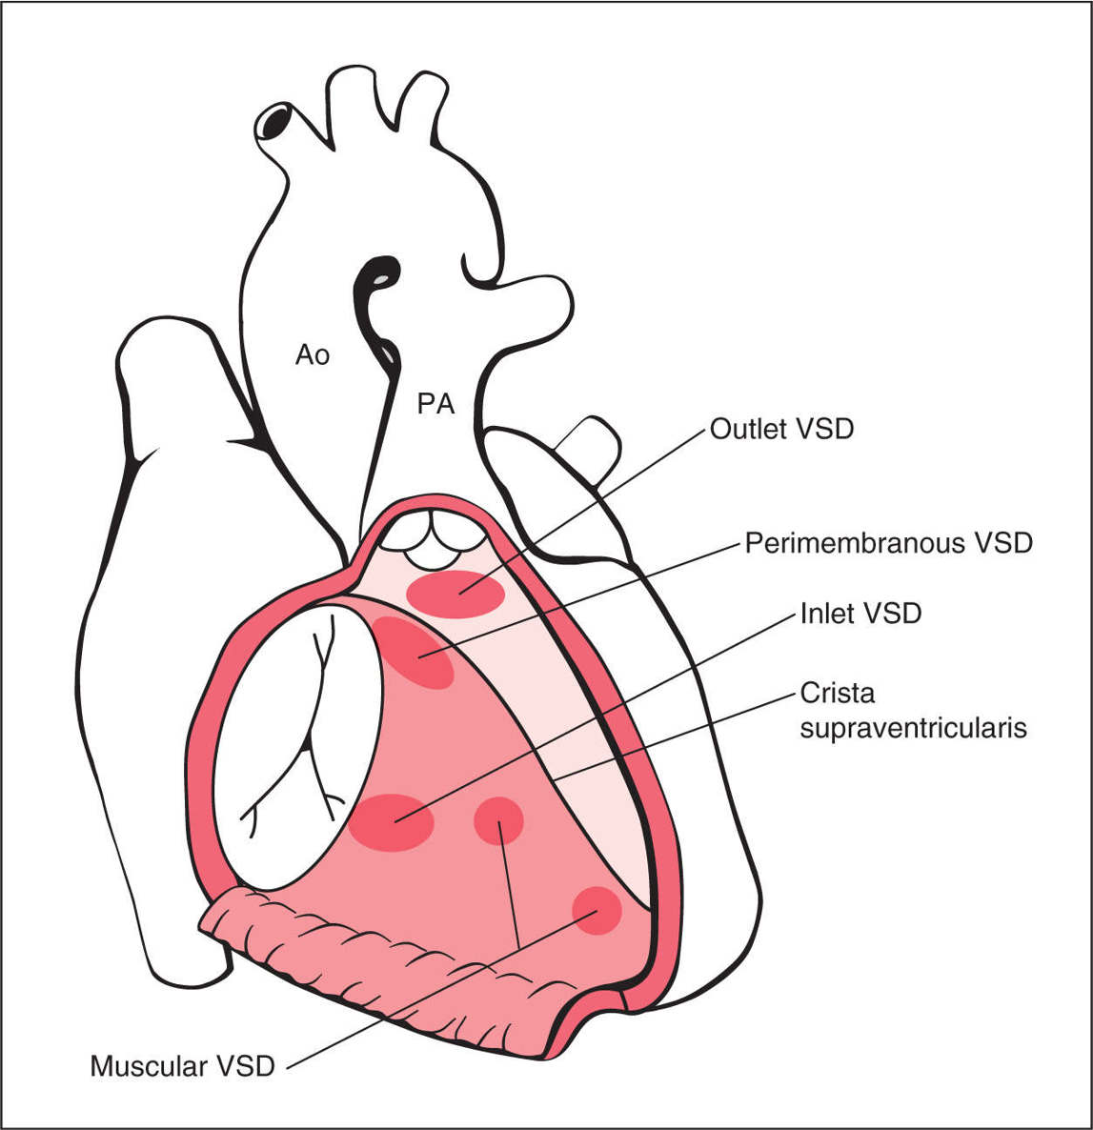

Slide 63
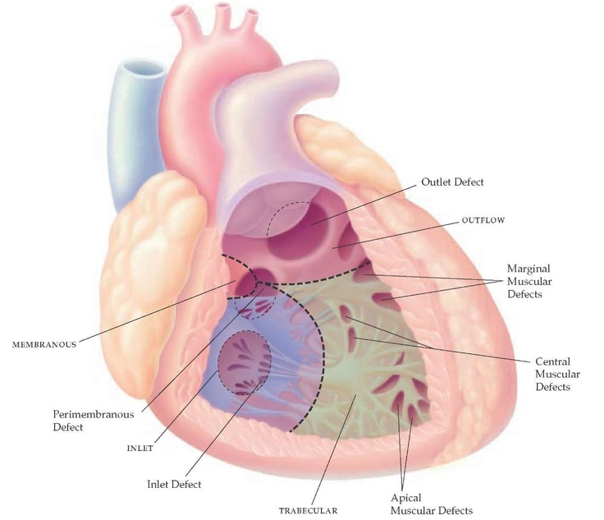

Slide 64
The membranous septum is divided by the tricuspid annulus into ventriculoatrial and interventricular componenets
The membranous septum abuts the major segments of the muscular septum namely, the inlet septum, which is highly trabeculated, the trabeculated septum, which is heavily trabeculated and the infundibular septum which is nontrabeculated

Slide 65
Types of vsd
perimembranous- Approximately 80% of the VSD are perimembranous.
Large perimembranous defects encroach upon all three portions of muscular septum

Slide 66
Muscular vsd
Muscular VSD are prevalent in neonates.
Approx 90% of the defects close spontaneously within the first 10 months of life.
The most common type of muscular defects lie within the trabecular septum.
Vary from small to large from single to multiple, to a honeycombed or swiss cheese like structure with sieve like fenestrations to tortuous sinusoidal tracks

Slide 67
Isolated defects in the inlet septum represent approx 8% of VSD
The infundibular septum is represented by a small portion interposed between the outflow and compartments of the left and the right ventricles.
VSD in the infundibular septum are also called as supracristal, subpulmonary, subarterial or doubly committed – approx 5-7% of VSD
Infundibular defects can be entirely muscular or can be partially rimmed by semilunar valve tissue (subarterial)

Slide 68
Doubly committed subarterial- when little or no muscle is interposed between the outflow components of the left and right ventricles
Aortic and pulmonary leaflets are in fibrous continuity
These defects lie immediately beneath the valves of both arterial trunk – so the LCC and RCC of the aortic valve tend to prolapse into the outflow tract of the right ventricle

Slide 69
Hemodynamic classification
Restrictive- Qp/Qs ≤ 1.4: 1
Moderatively restrictive- Qp/Qs 1.4- 2.2
Large or nonrestrictive VSD – QP/Qs > 2.2
Eisenmenger VSD- Qp/Qs < 1

Slide 70
Natural history
About 50-75% 0f restrictive perimembranous and trabecular muscular defects close
Moderately restrictive and nonrestrictive defects close spontaneously but low probability (5-10%)
Most defects close within 1st year
Approx 60% close before 3 yrs and 90% close by 8 yrs
Multiple muscular trabecular defects have strong tendency to close

Slide 71
Defects in the inlet septum seldom decrease in size but are occasionally occluded by bridging atrioventricular valve tissue
Infundibular defects can be closed by the prolapse of the right aortic cusp
Perimembranous VSD close by adherence of the septal tricuspid leaflet to the margins of the defect, less commonly by prolapse of an aortic cusp

Slide 72
Other structural anomalies
COR TRIATRIATUM
On the left side of the heart, if incorporation of the common pulmonary vein into the left atrium is incomplete, the result is a septum like structure that might derive from the left pulmonary ridge and divides the left atrium into two components – one receiving the pulmonary vein and the other giving access to mitral valve and left atrial appendage

Slide 73
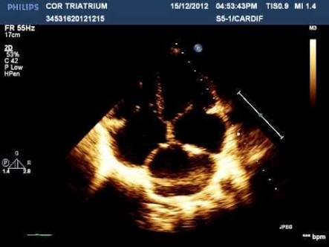

Slide 74
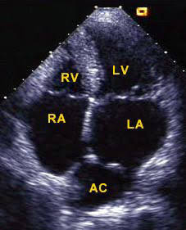

Slide 75
PERSISTENT LEFT SUPERIOR VENA CAVA
Persistence of the left common cardinal vein and left sinus horn results in a left superior vena cava draining into the coronary sinus

Slide 76
MCQS

Slide 77
  From where does the endocardial heart tube derived ?
  Ectoderm
  Endoderm
  Somatopleuric mesoderm
  Splanchnopleuric mesoderm
  Ans- 4

Slide 78
Left horn of the sinus venosus becomes?
SVC
IVC
Coronary sinus
Left atrium

Slide 79
Which of the following statements regarding the partioning of the atria is correct
Septum primum is thick and muscular
Septum secondum is a transient structure which degenerates by 4th week
Ostium secondum forms by apoptosis in the central part of septum secondum
Septum primum froms the valve of foramen ovale

Slide 80
Which of the following doesn’t involve in the formation of membranous part of interventricular septum?
1.Left bulbar ridge
2.Right bulbar ridge
3.Right AV cushion
4.Left AV cushion
Ans- 4

Slide 81
Gerbode defect?
1.Right ventricle to left atrium shunt
2.Left ventricle to right atrium shunt
3. Interatrial shunt
4. Interventricular shunt

Slide 82
If fusion of endocardial cushions is too far to the right?????
Tricuspid atresia

Slide 83
thank u

